Slide 1
otsdaq Brief Overview
Ryan A. Rivera
6 December 2016

Slide 2
Motivation
Trends:
Tighter budgets for experiments leading to reluctance to subsidize DAQ development.
Industry moving from centralized crates and backplane systems to distributed systems connected by high speed links.
Ethernet and Internet Protocol has been the one communication technology standard that has far outlived any other. IoT market value was $1.9 trillion in 2013 and estimated up to $19 trillion by 2020.
$6K for a 1U 48-port 10G Ethernet switch with throughput > 1000 VME Crates!
Notes:
http://www.connectorsupplier.com/obituary-for-backplane-based-systems/

Slide 3
The Vision
It’s easy to get overwhelmed by all the IoT options when choosing a development platform.
otsdaq brings value to the table by surveying and narrowing the options and providing a coherent package connecting hardware and software geared toward HEP.
We want to maintain an emphasis on scaling down.
Let the physicists do physics instead of reinventing the DAQ wheel.

Slide 4
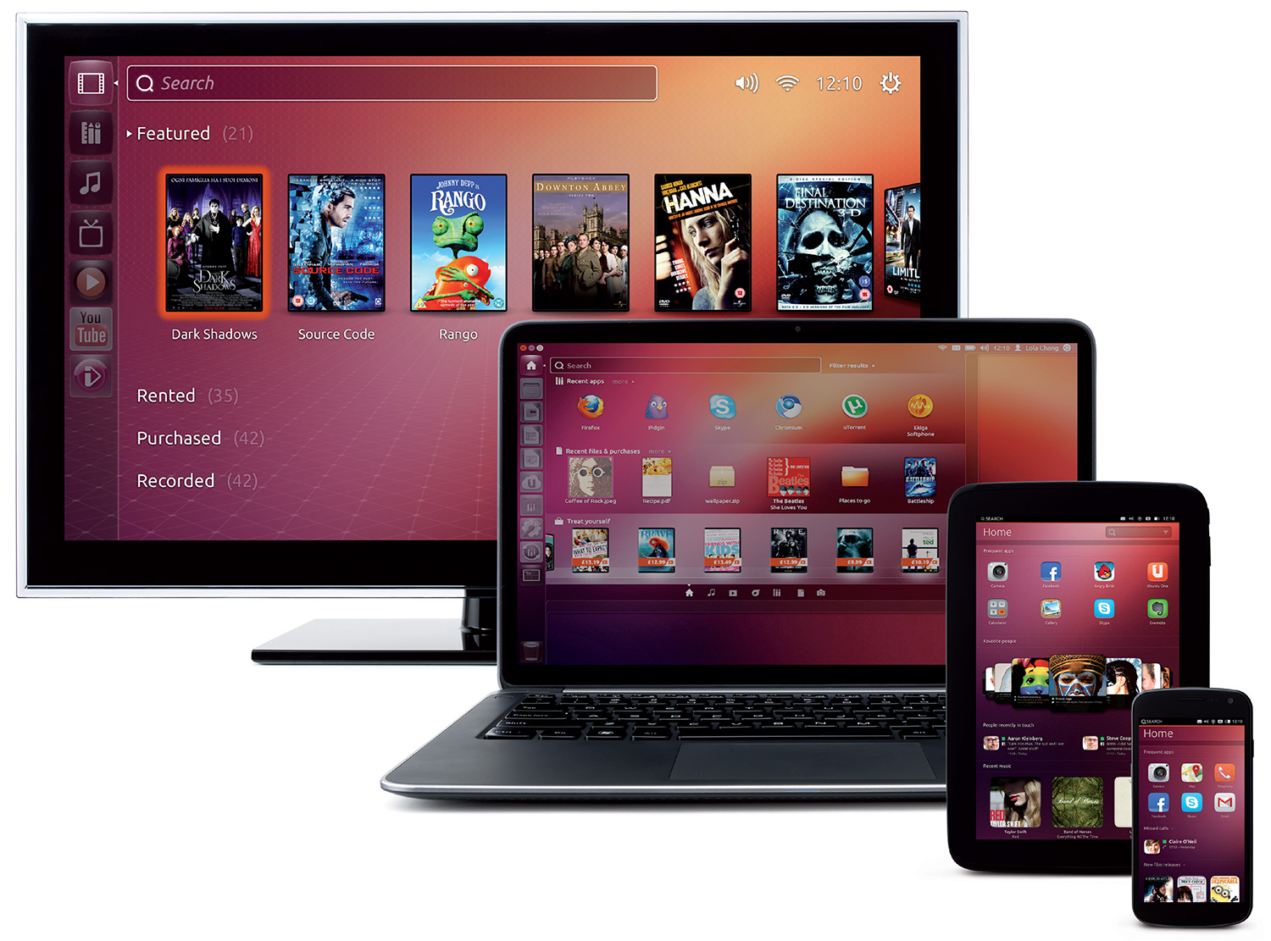
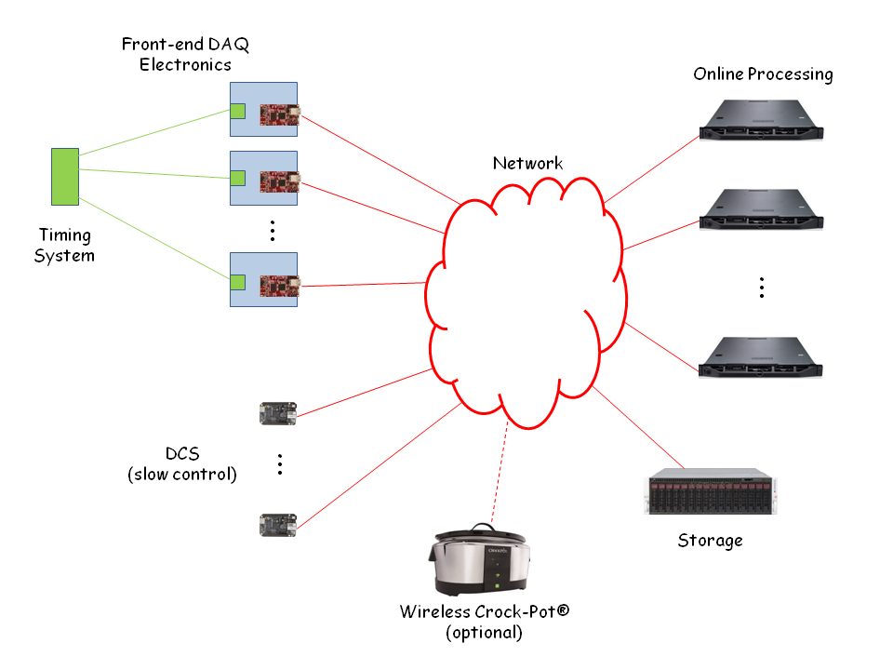
In Progress
We are developing a low cost, data acquisition architecture as a service, based on commercial IoT technology that is scalable from a few MBytes/sec to hundreds of GBytes/sec.
Web GUI

Slide 5
This concludes the overview
The following slides are images of otsdaq in action.

Slide 6
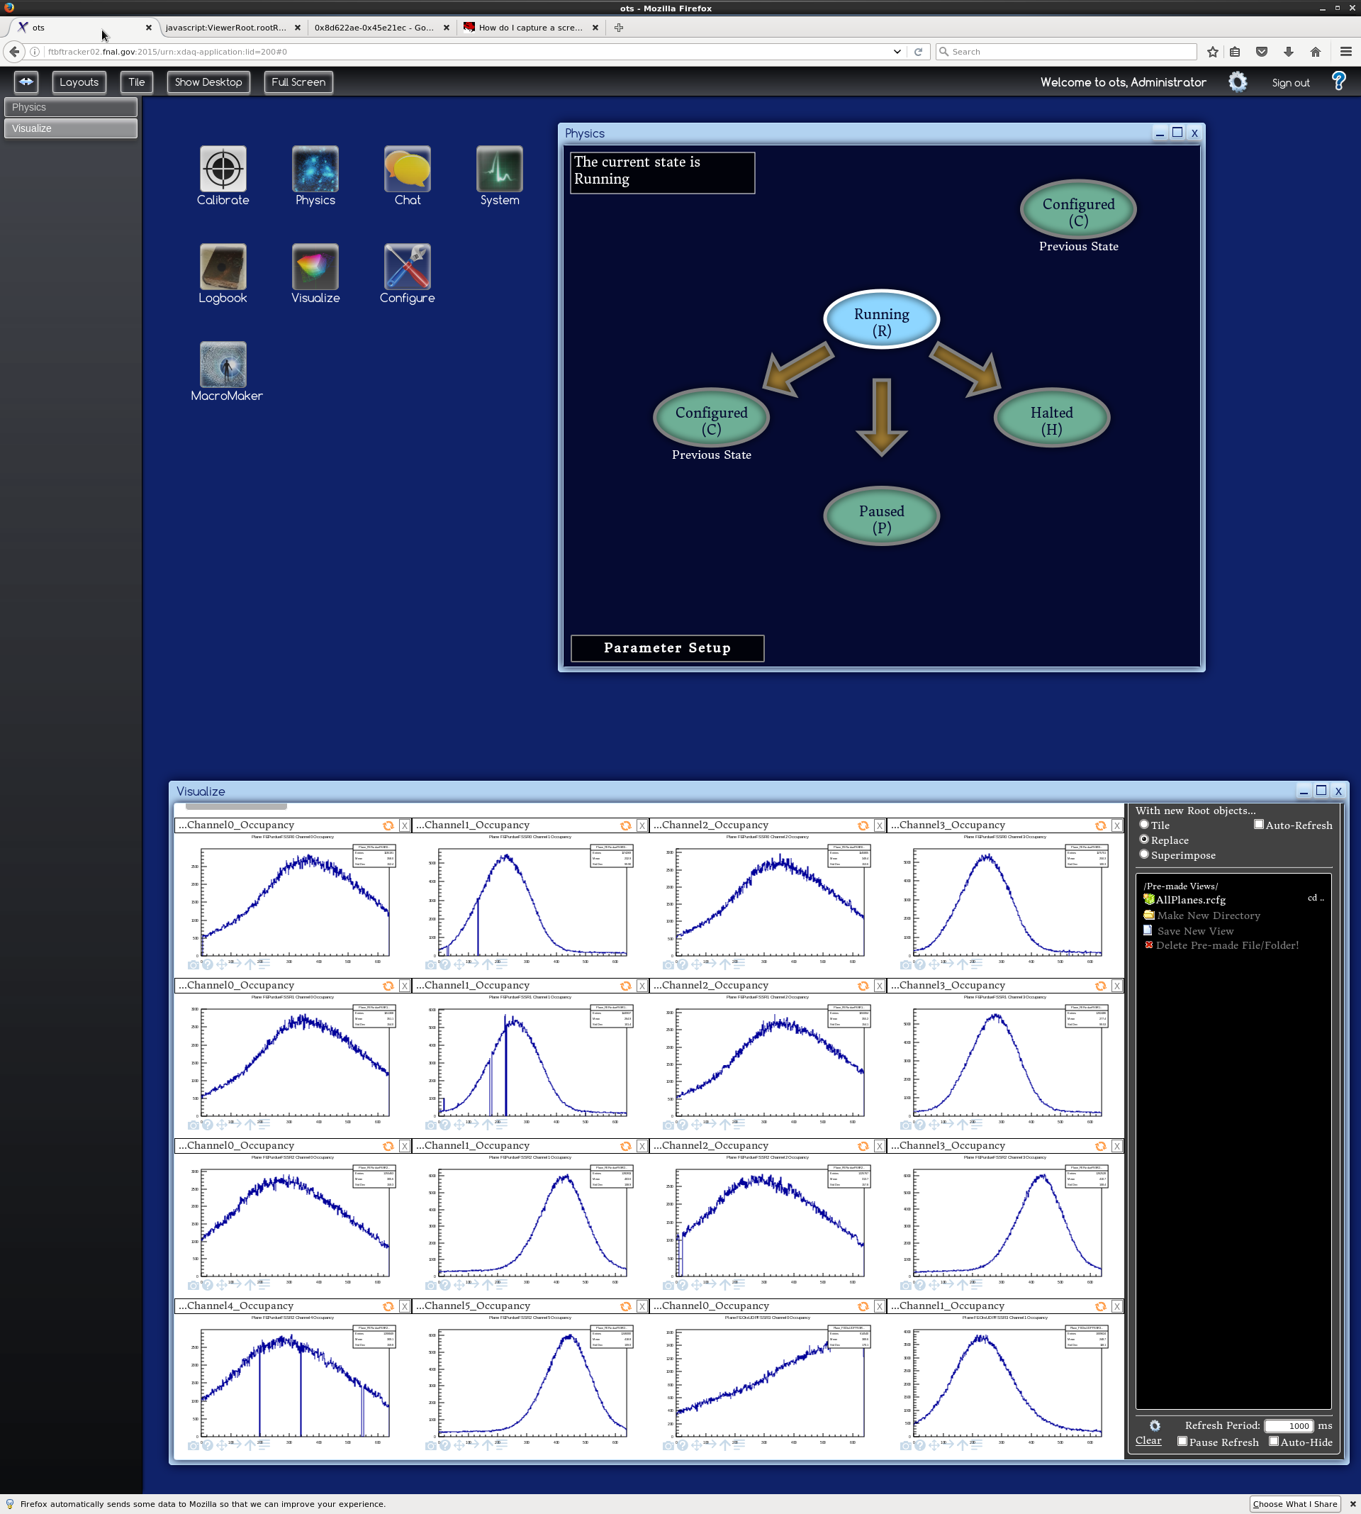

Slide 7
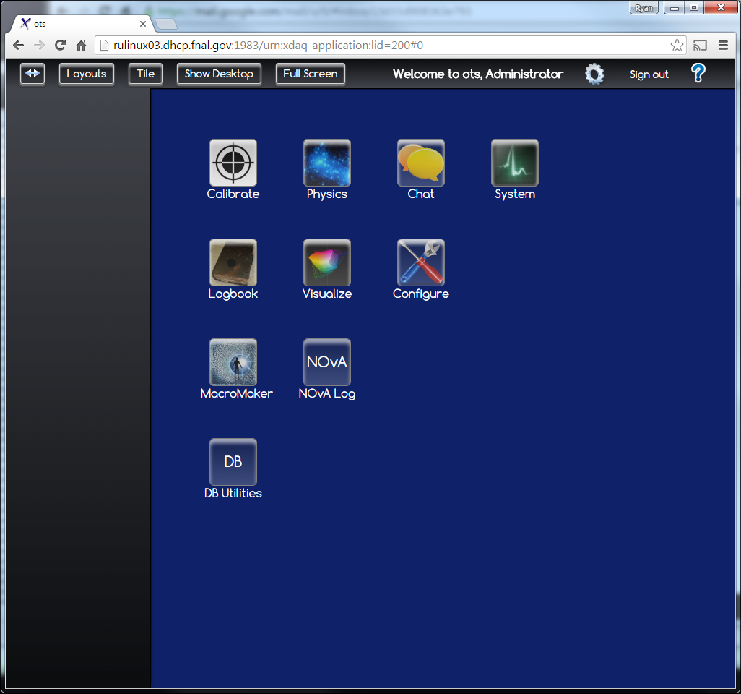
Status continued

Slide 8
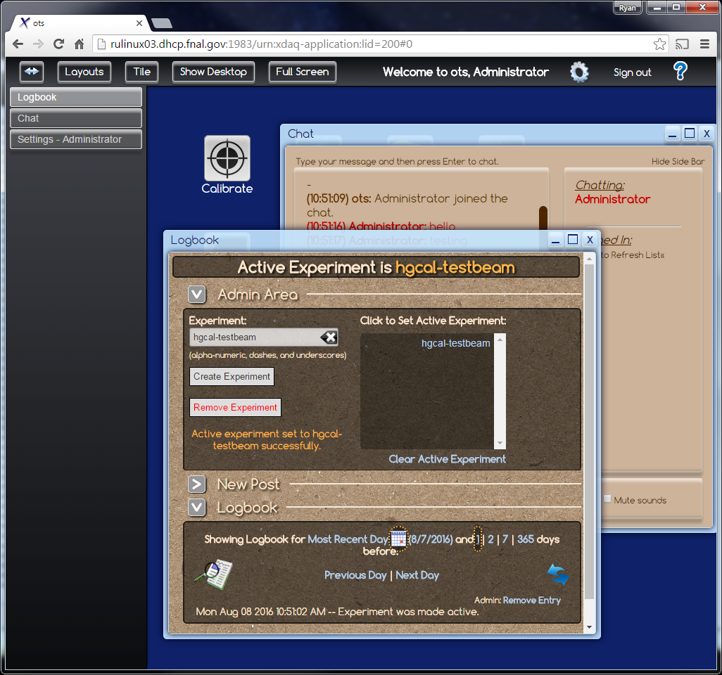
Status continued

Slide 9
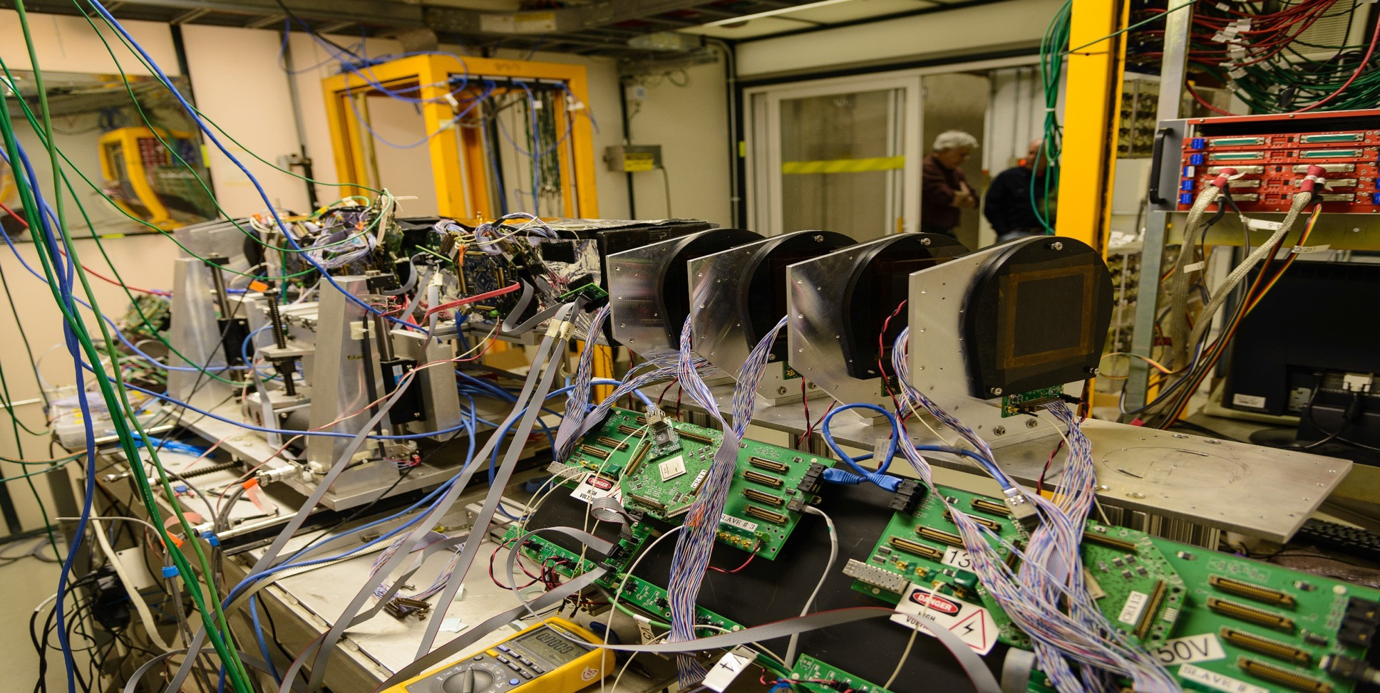
Fermi Test Beam Facility is Our Test Bed

Slide 10
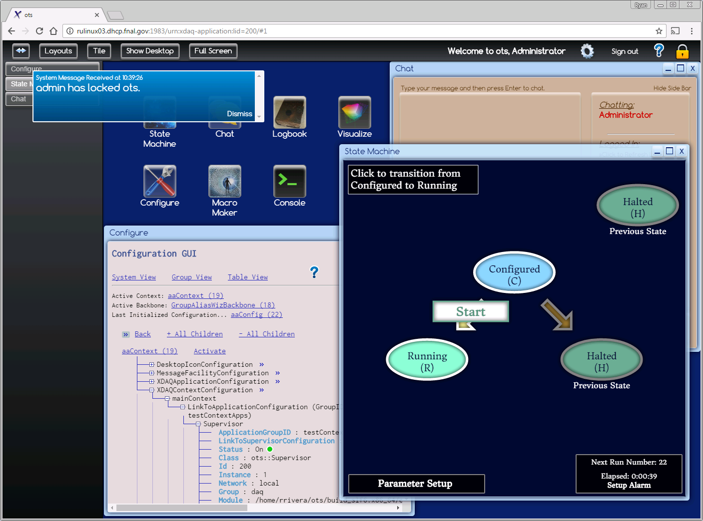
Current Web GUI
Notes:
Desktop-based Web Graphical User Interface

